Slide 1
A Case Study in Formal Specification and Runtime Verification of a CubeSat Communications System
Zachary Luppen, PhD Student
Dae Young Lee, Phd; Kristin Yvonne Rozier, PhD
20 October 2020

Slide 2
Introduction Key Points
CubeSats are becoming widely used by various groups owing to their relatively low cost and fast turnaround times.
CubeSat communications systems are extremely important to any mission.
Communications system failures are one of the most common types of failures with CubeSat missions .
Formal methods are used to specify, develop and verify software and hardware systems, but despite failures being common, nobody has used the techniques with CubeSats.

Slide 3
Key Point 1
“CubeSats are becoming widely used by various groups owing to their relatively low cost and fast turnaround times.”
Academic, government, commercial as well as amateur entities.
CubeSats offer a scaled-down platform for researchers looking to perform experiments.
As of June 2020, over 1,300 CubeSats have flown in space (not all were operational).

Slide 4
Key Point 2
“CubeSat communications systems are extremely important to any mission.”
Without a working communications system, the CubeSat is essentially useless. No different than a piece of space junk.
While a CubeSat could be powered on properly and collecting data to perform invaluable science (all other systems are completely flawless), a failure to communicate that information back to the ground makes the entire mission pointless.
Klofas, B., and Anderson, J., “A Survey of CubeSat Communication Systems,” 2008.

Slide 5
Key Point 3
“Communications system failures are one of the most common types of failures with CubeSat missions .”
Communications system failures are currently one of the most commonly widespread problems experienced by CubeSat developers.
Failures can be attributed to lack of experience, poor design, incorrect link budgeting (used to guide design), electrical failures, and several other causes.
Langer, M., and Bouwmeester, J., “Reliability of CubeSats – Statistical Data, Developers’ Beliefs and the WayForward,” 2016.
Mike Tolmasoff, Renelito Delos Santos, and Catherine Venturini, “Improving Mission Success of CubeSats,” Proceedings of the U.S. Space Program Mission Assurance Improvement Workshop, 2007.

Slide 6
Key Point 4
“Formal methods are used to specify, develop and verify software and hardware systems, but despite failures being common, not many research groups have used the techniques with CubeSats.”
Used sparsely in the field. Most relatable work involved applying a decision module to compare ADCS controllers and verify an unverified controller.
Since communications failures are quite common among satellites, they present the perfect opportunity to apply methods that have been used to verify other systems.
Peng, Z., Lu, Y., Miller, A., Johnson, C., and Zhao, T., “A Probabilistic Model Checking Approach to Analysing Reliability, Availability, and Maintainability of a Single Satellite System,”2013 European Modelling Symposium,2013, pp. 611–616. https://doi.org/10.1109/EMS.2013.102.
Boufaied, C., Menghi, C., Bianculli, D., Briand, L., and Isasi, P. Y., “Trace-Checking Signal-based Temporal Properties: A Model-Driven Approach,” 2020.
Gross, K. H., Clark, M., Hoffman, J. A., Fifarek, A., Rattan, K., Swenson, E., Whalen, M., and Wagner, L.,Formally Verified Run Time Assurance Architecture of a 6U CubeSat Attitude Control System, chapter and pages.https://doi.org/10.2514/6.2016-0222, URL https://arc.aiaa.org/doi/abs/10.2514/6.2016-0222.

Slide 7
CubeSat Communications System
Produce a program that simulates and animates a CubeSat orbiting the Earth, provides information indicating when the CubeSat could communicate with a virtual ground station (based off Link equation)
When communication is viable, have simulated communications system that transmits information from a transmitting antenna (emulating the CubeSat) to a receiver (emulating the Ground Station)
Utilize software defined radio (SDR) technology to perform the communication, using Simulink and Matlab programs (can still mention GNU Radio attempts)

Slide 8
Keypoint 1
“Produce a program that simulates and animates a CubeSat orbiting the Earth, provides information indicating when the CubeSat could communicate with a virtual ground station (based off Link equation)”
Use the Aerospace Blockset CubeSat Simulation Library, allows simulation and visualization of a modeled CubeSat in orbit
Matlab program written by Dr. Lee used an antenna gain file and the link equation to understand when the CubeSat could communicate with a virtual ground station
Keep track of this information and understand how much data could theoretically be downlinked during a given period, provide a trigger to the communications portion.

Slide 9
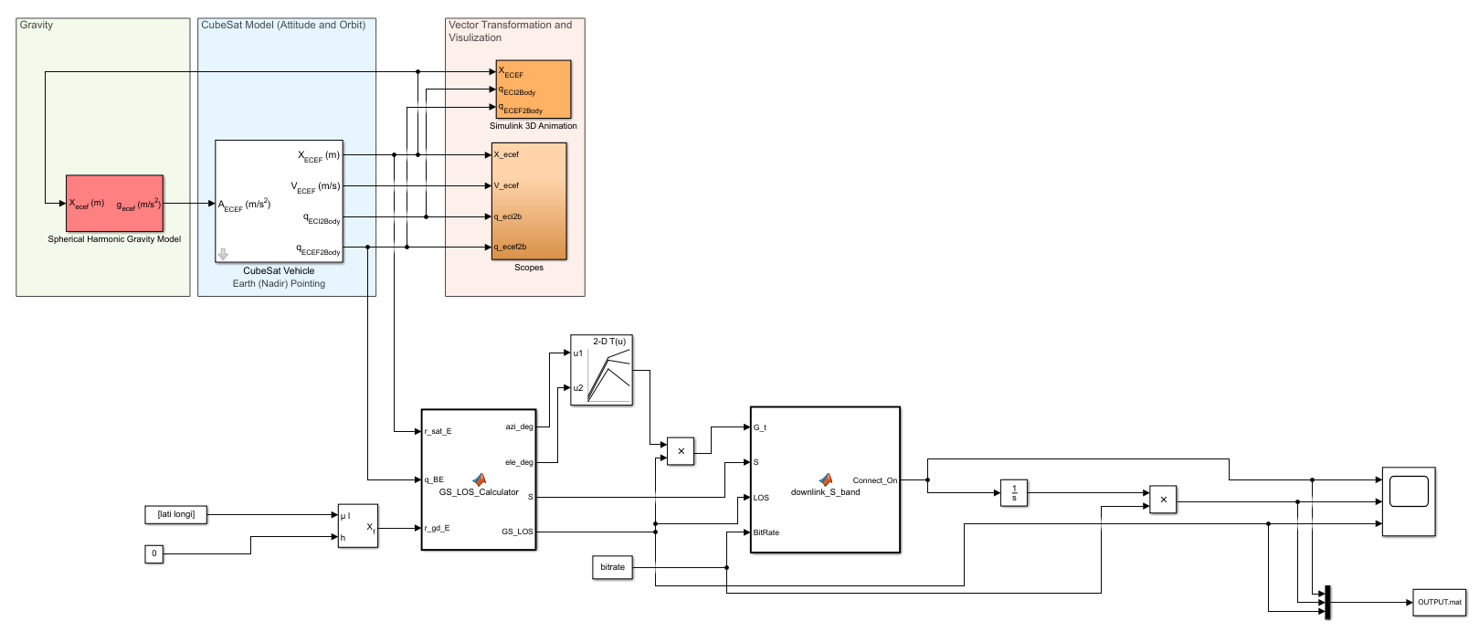
Simulink Model used to simulate CubeSat

Slide 10
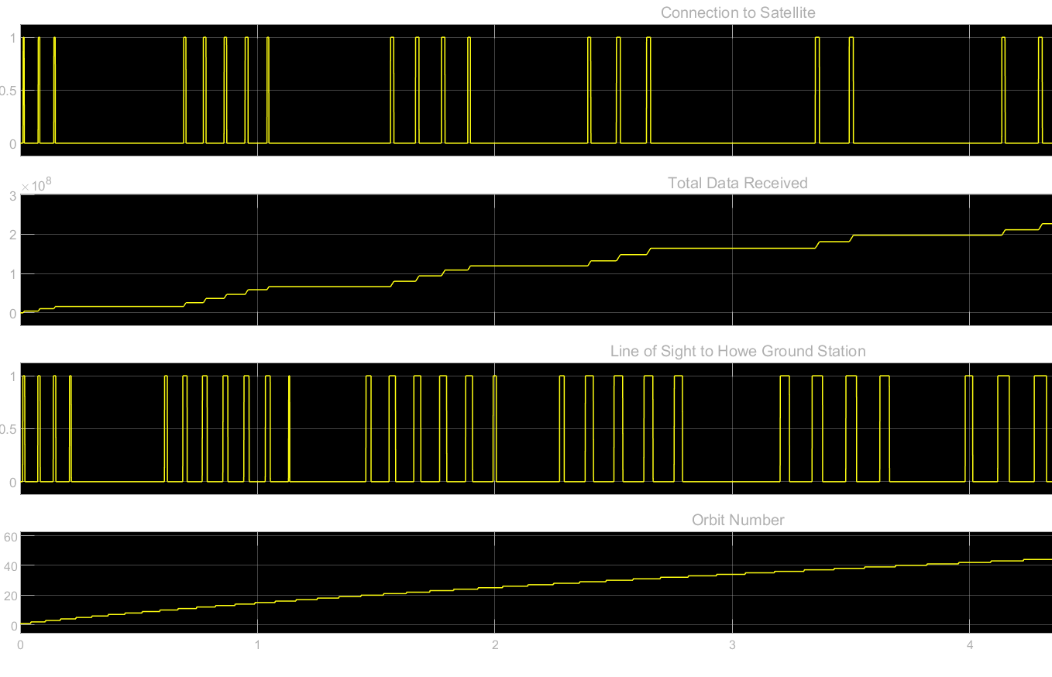


Slide 11
Keypoint 2
“Develop a simulated communications system that transmits information from one PC (emulating the CubeSat) to another (emulating the Ground Station)”
We develop a protocol wherein communications are “established (LOS achieved)” from the orbital simulation, triggering the transmitting radio
The receiver, which can “track” the CubeSat, waits for a transmission
Transmission is received, telemetry data is saved to file

Slide 12
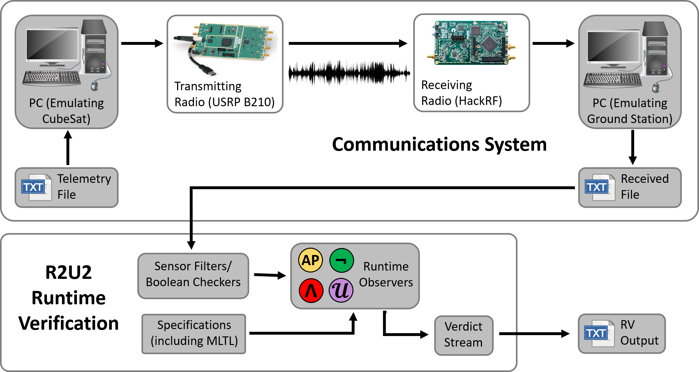

Slide 13
Keypoint 3
“Utilize software defined radio (SDR) technology to perform the communication, using Simulink programs”
We use the Simulink Communications library for its flexibility and versatile functionality that can be used to program SDRs.
Use UDP communication to receive information from the CubeSat model as an indicator for when to transmit
Broadcast information that gets received and saved to a file
Choi, T., Stevenson, T., and Lightsey, E. G.,Reference Ground Station Design for University Satellite Missions with Varying Communication Requirements, chapter and pages. https://doi.org/10.2514/6.2017-1334, URLhttps://arc.aiaa.org/doi/abs/10.2514/6.2017-1334.

Slide 14
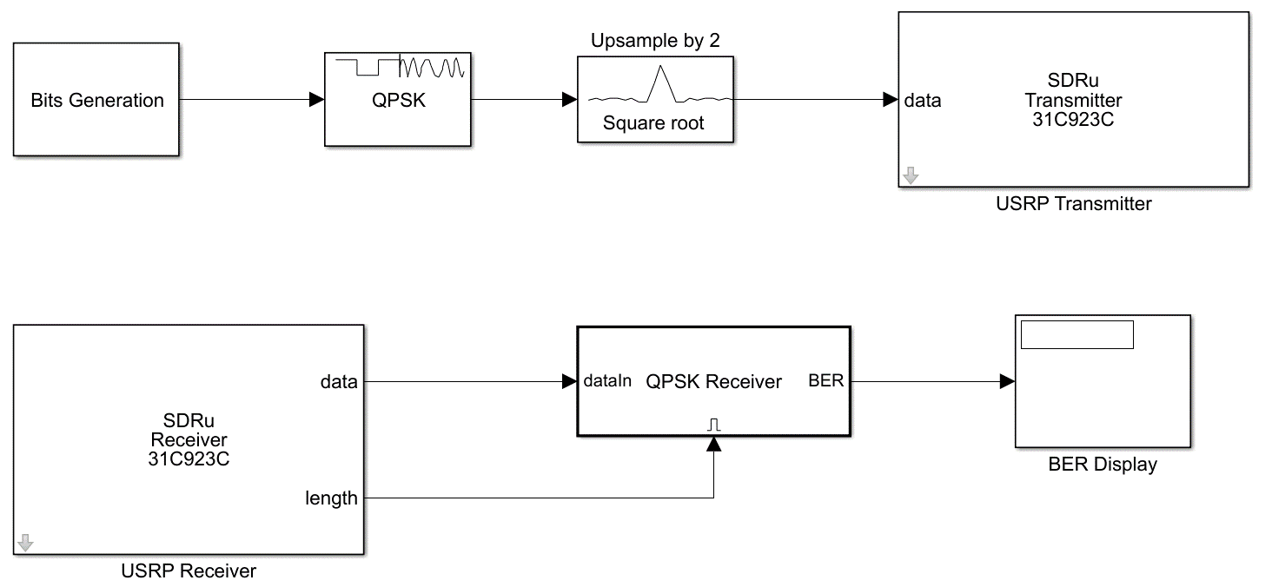
TX-RX

Slide 15
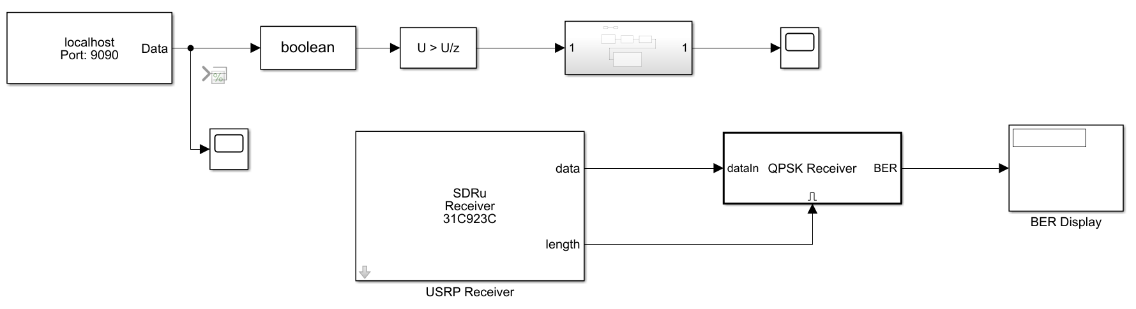
TX-RX Model with UDP Information

Slide 16
Application of Formal Methods
System is described using mission-time linear temporal logic (MLTL) specifications
MLTL is defined and explained
Specs relating to communications model and received telemetry
These specifications are read into R2U2, and the data/telemetry that is available from the receiver (as well as the CubeSat model) is compared against them
R2U2 is described, discussion of how the process works
Demonstration, sample output

Slide 17
Keypoint 1
“System is described using mission-time linear temporal logic (MLTL) specifications”
Examine orbital information. Ensure that the location tracking of the CubeSat is correct.
Monitor telemetry variables.
Examples include:
Communication isn’t possible when the CubeSat is below the horizon.
Azimuth and Elevation angles must match
The receiver cannot receive a message until it is transmitted.
Notes:
CubeSat acts as a black box, as that’s mostly how it would be in a real system.

Slide 18
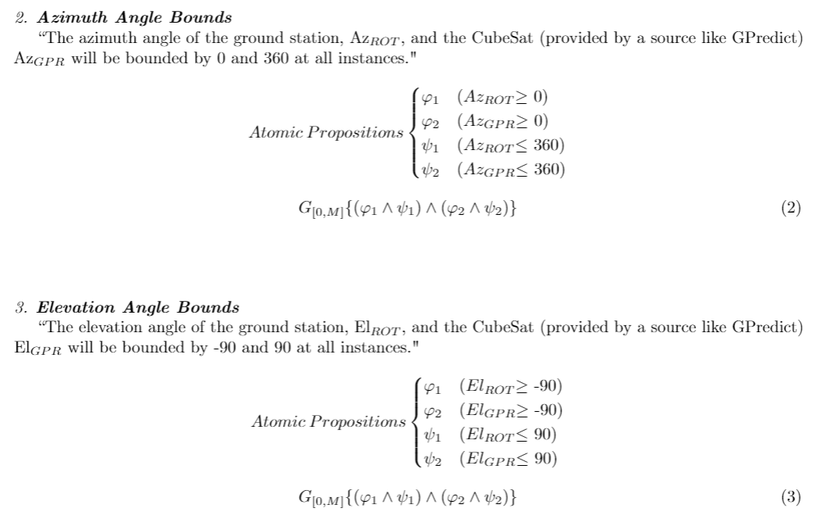

Slide 19
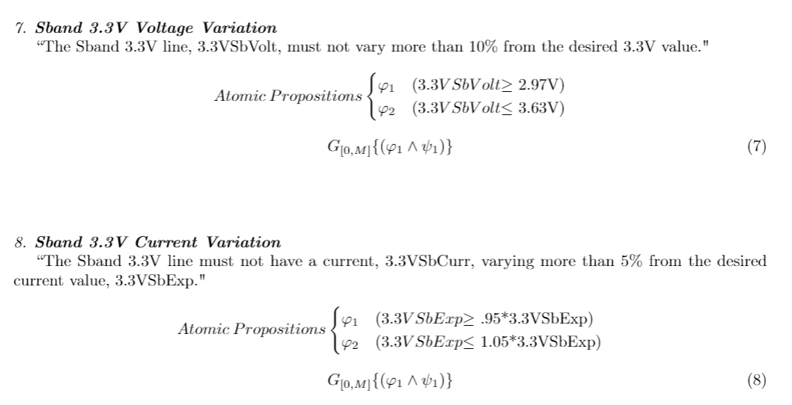

Slide 20
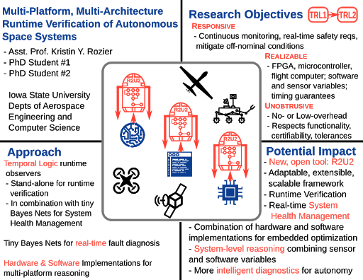
Keypoint 2
These specifications are read into R2U2, and the data/telemetry that is available from the receiver (as well as the CubeSat model) is compared against them”
R2U2 takes specifications and data, compares data
against the specified conditions
Run R2U2 with multiple datasets, some having
perfect data and others with specific failures
Demonstrate why MLTL is so useful for reasoning
about this kind of system
Notes:
CubeSat acts as a black box, as that’s mostly how it would be in a real system.

Slide 21
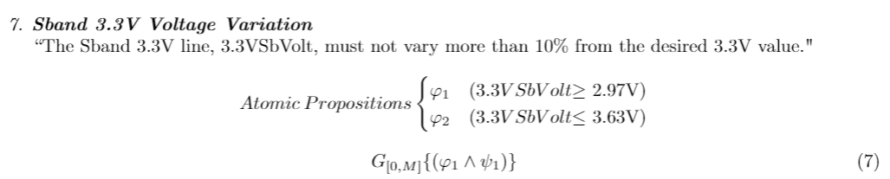
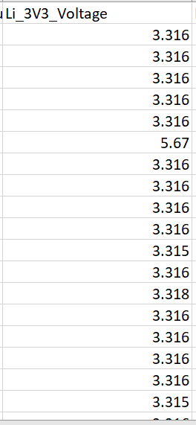
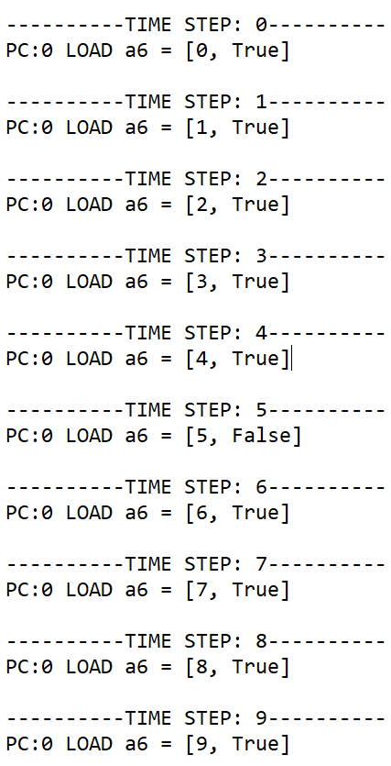
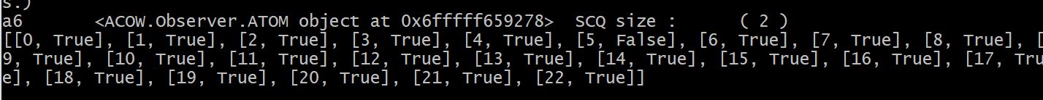
Example (w/o bound on temporal operator)
We see at Time Step 5 that the specification is not met. Normally, this would flag an error since it’s off-nominal. However, we see that the data returns to nominal values afterwards.
With this spec, one bad data point is a malfunction.

Slide 22
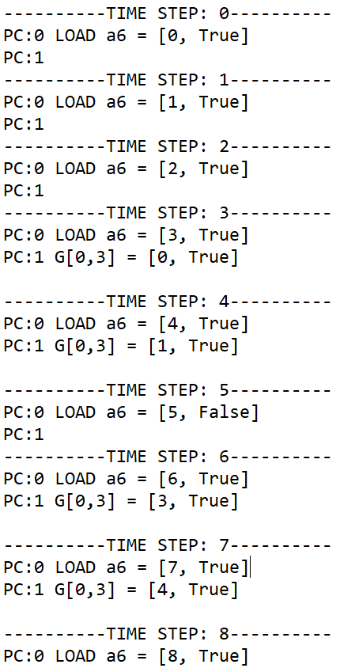
Example (w/o bound on temporal operator)
We see at Time Step 5 that the specification is not met. However, we give a bound on the temporal operator, i.e., G[0,3], then we allow the data to return to normal in a couple steps before flagging an error.
Since the data returns to nominal values, no error gets flagged below.

Slide 23
Results
Specifications were written with the knowledge that hardware will experience off-nominal data points during its lifetime.
We design a simulated communications system that is monitored off-line using R2U2.
If R2U2 determines that the system is not meeting specifications, then the tool will flag the time step at which the system failed, as well as let the user know how it failed/what wasn’t satisfied.
For designing a system, specifications could be re-written whenever needed. There’s a lot of design flexibility beforehand, not so once the mission is in operation.
The results from R2U2, compounded overtime, allow us to understand how the entire system performs throughout its lifetime. Don’t need someone to check system health, process is automated.

Slide 24
Contributions
Show how formal methods can be used to verify a single CubeSat subsystem. In a more comprehensive view, wanting to demonstrate their use in the world of CubeSats.
Discuss the utility of a runtime verification tool specifically with CubeSat systems, which can be used to understand design issues, problems, etc.
Demonstrate the need for MLTL specifically with these systems, due to inherent imperfections with hardware.
Discuss formal methods used for solving problems in other aerospace fields and show how they’re just as useful for CubeSat systems.

Slide 25
Comparison to Relevant Works
Other works have looked to simulate controllers and verify their operation and use specific trace-checking software to examine specific patterns in a data trace.
Here, we’re applying specification and verification to a single CubeSat system, monitor its operation over time.
Gross, K. H., Clark, M., Hoffman, J. A., Fifarek, A., Rattan, K., Swenson, E., Whalen, M., and Wagner, L.,Formally Verified Run Time Assurance Architecture of a 6U CubeSat Attitude Control System, chapter and pages.https://doi.org/10.2514/6.2016-0222, URL https://arc.aiaa.org/doi/abs/10.2514/6.2016-0222.
Boufaied, C., Menghi, C., Bianculli, D., Briand, L., and Isasi, P. Y., “Trace-Checking Signal-based Temporal Properties: A Model-Driven Approach,” 2020.

Slide 26
Conclusion
Explored the benefits that formal methods like specification and runtime verification have for a simulated CubeSat communications system.
Good specifications written in MLTL show how designers want the system to perform, while also accounting for the occasional errors that sensors inherently experience.
Embedding R2U2 into the receiver software demonstrates how the communications system of a CubeSat project can be autonomously monitored to check for nominal performance.

Slide 27
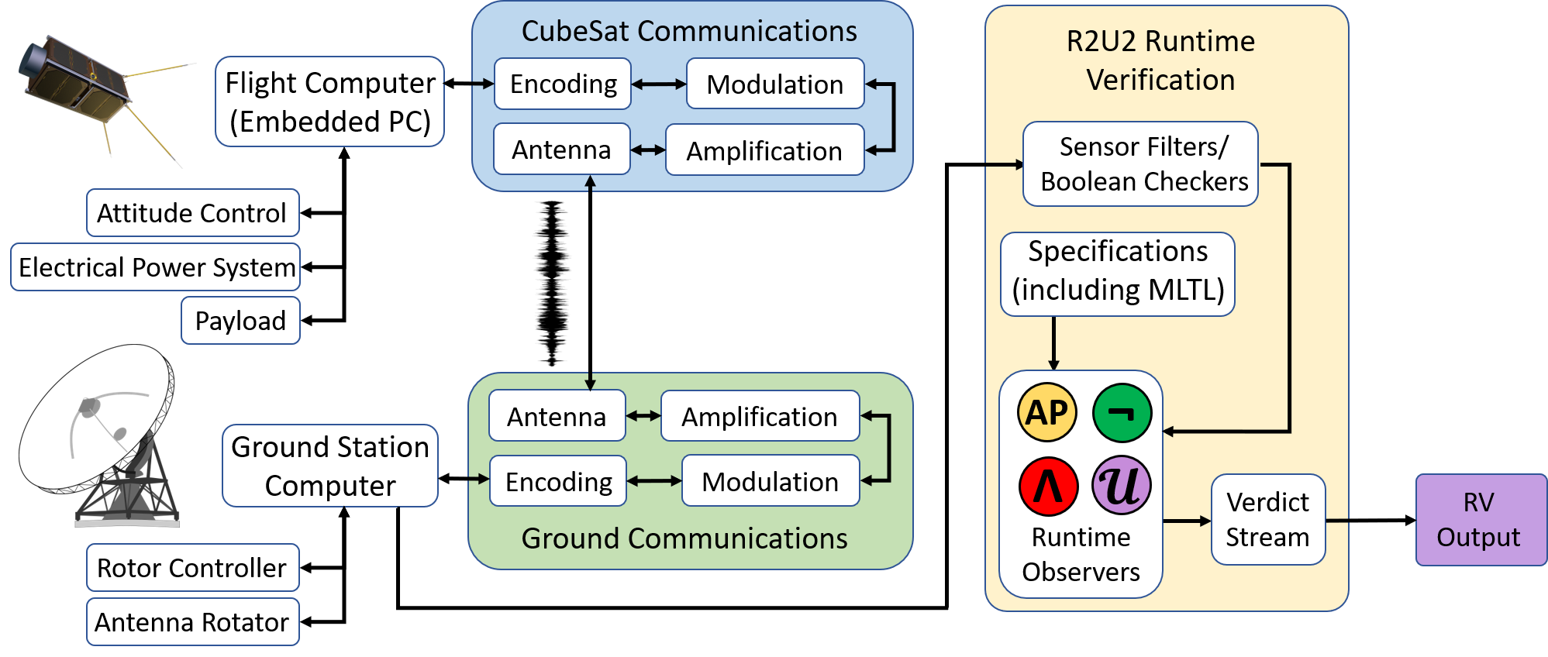
Future Work
Apply formal methods in the design of other CubeSat subsystems, such as an electrical power system (EPS) and an attitude determination and control system (ADCS).
Useful in evaluating CubeSat telemetry from the ground station, and autonomously verifying whether the CubeSat’s performance at that time is nominal.
Applying the methods to a real CubeSat system is the ultimate demonstration.

Slide 28
Questions?

